Slide 1
User Experience ?
Amir Dirin

Slide 2

History lesson
The very first people interacting with computers were scientists, programmers, engineers, and “Experts”

Slide 3
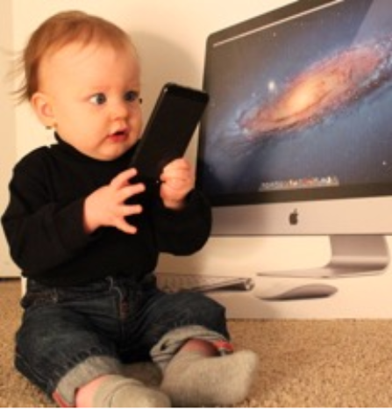
Today UX and UI
Many complex systems have been replaced or applied the power of computers
Human interaction has become constantly and increasing all the time.
UX&UI should improve how human interact with computers and complex systems

Slide 4
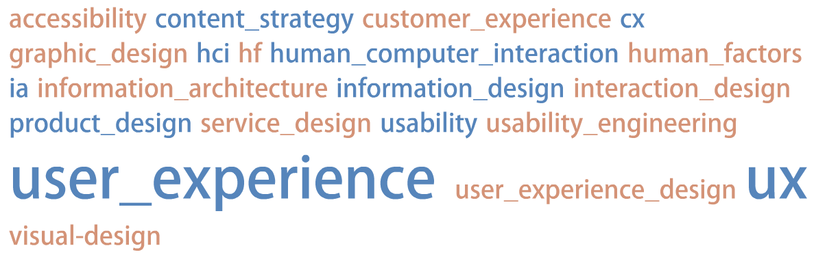
What is user experience?
Technologies-→ Functionalities
Utilities--→ Usability
Sustainability→ User experience
Amir Dirin, Marko Nieminen (2017). The three eras of mobile learning user experience. International Conference on Computer Supported Education (CSEDU). Porto, Portugal

Slide 5
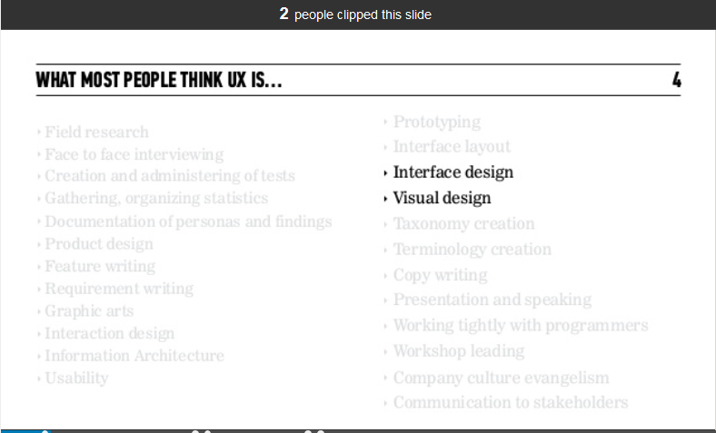
People definition of UX

Slide 6
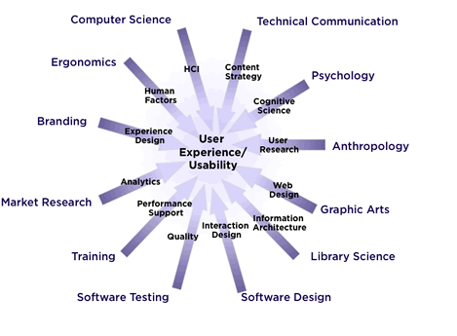
UX as research topic

Slide 7
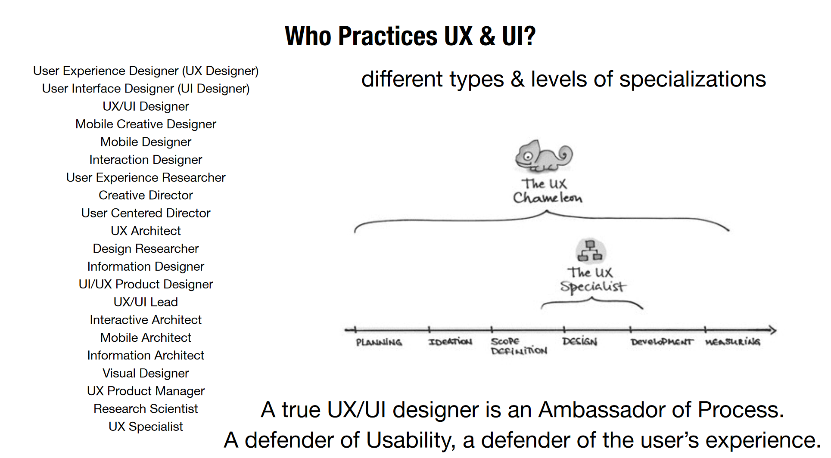
Who practices UX & UI?

Slide 8
User experience design (UXD)
User Experience is a discipline
User Experience is a process
User experience aims at improving a user engagement with the product
Small changes in a product has a significant impact on a product use

Slide 9
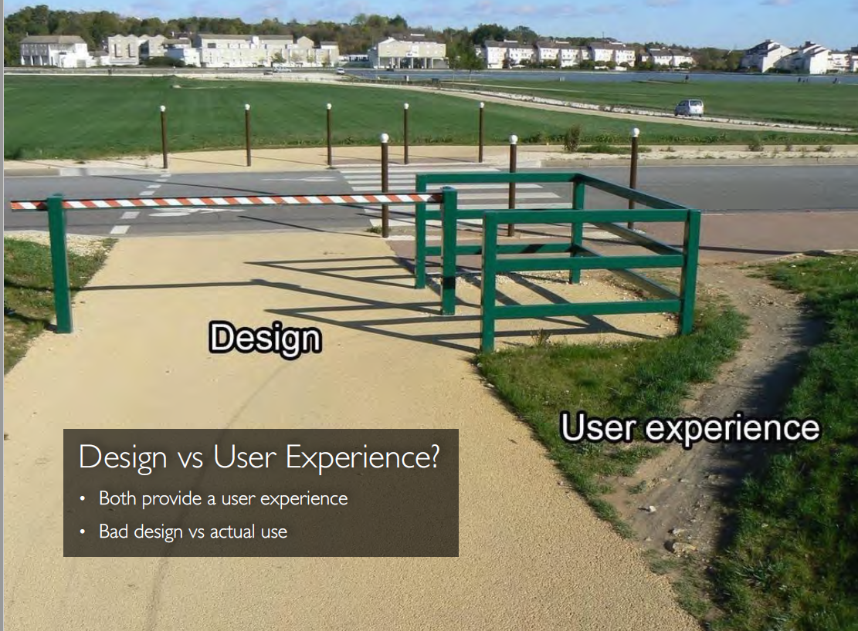
Example

Slide 10
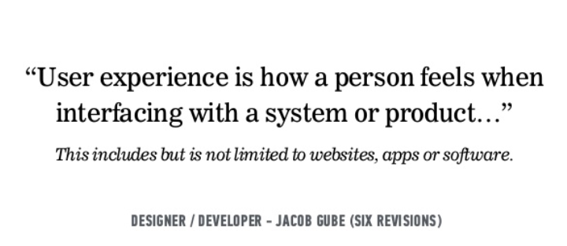
What is UX

Slide 11
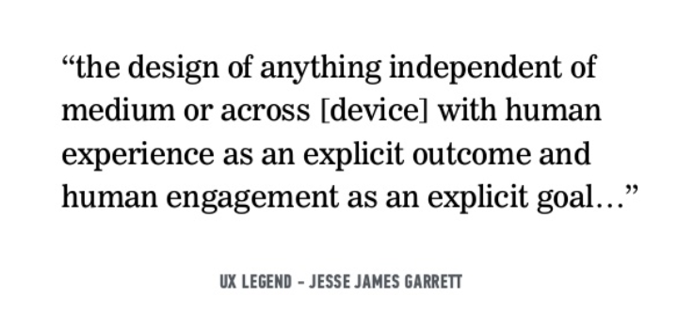
What is UX

Slide 12
UX and human factor
Human Factors comes from the field of psychology and focuses on understanding basic biological/human traits and mapping to user’s needs
The fast growth of information technology and the Internet have made UX a critical aspect of product and service design

Slide 13
Achieving UX
RESEARCH – ANALYSIS - DESIGN - EVALUATION
creating and designing the interface or experience the user expects or needs
once the interface or product is in a working state, users can test and evaluate if the interface or product maps to user’s mental model and needs
Understanding what the users need and their goals and behavior
Filter the noisy data out. Identify the actually requirements and needs.

Slide 14
Methods
RESEARCH | ANALYSIS | DESIGN | EVALUTION
Interview | Interview transcript coding | Paper prototypes | Usability testing
Observation | Affinity diagram | Storyboarding | Expert Review
Survey |  |  | Heuristic Review

Slide 15
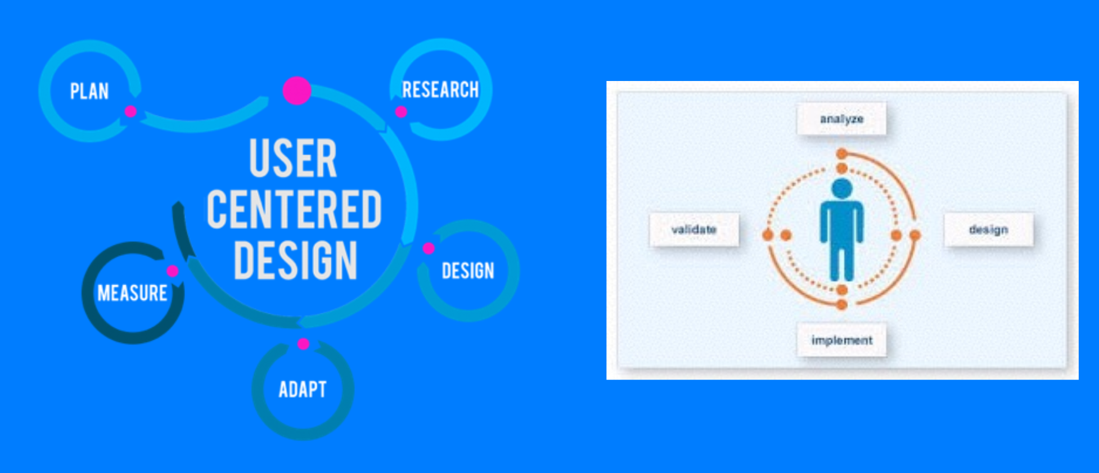
User Centered Design

Slide 16
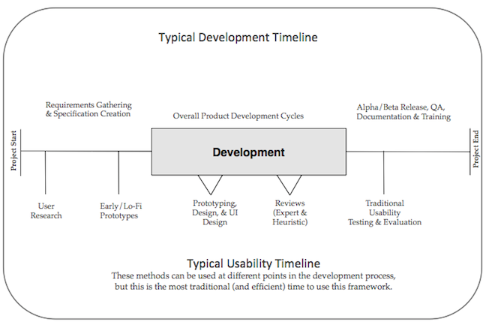
The development timeline

Slide 17
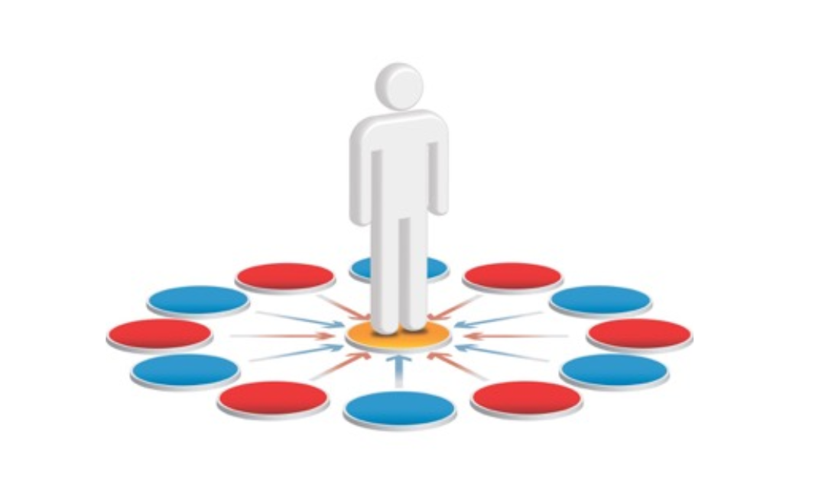
Capital U (User)
UCD Puts the User in the middle of the system design

Slide 18
Methods
This listing on the previous slide is only a small sampling of the most common methods
There are many other methods available and used and due to the interdisciplinary nature of the field, we keep expanding the number of methods our field uses

Slide 19
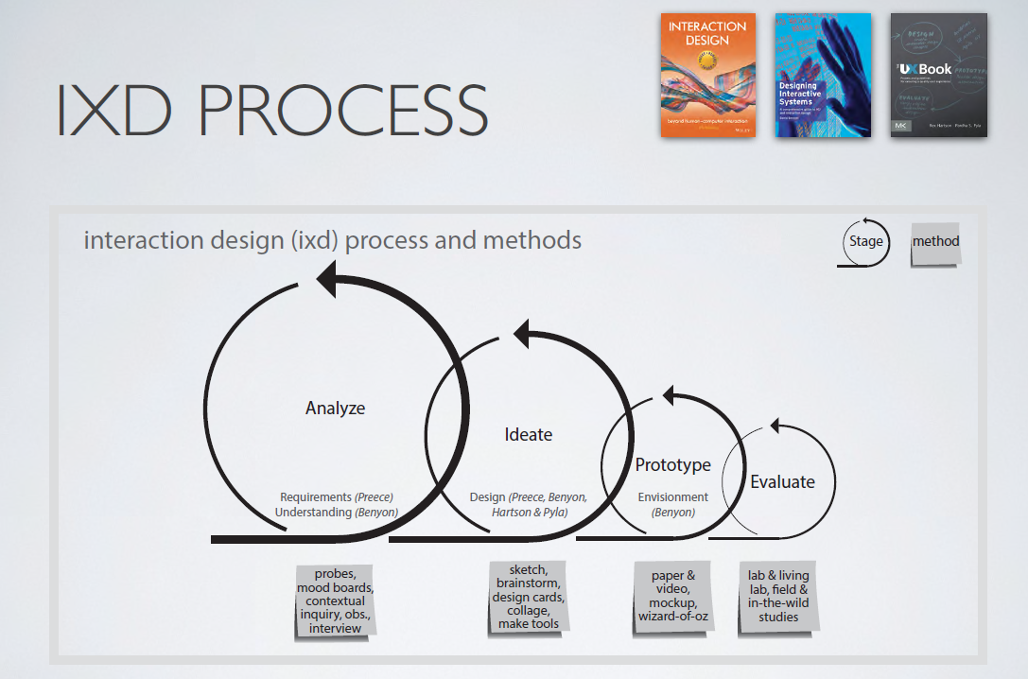
Interaction Design

Slide 20
Context within User Experience (UX)
Part of the overall issue with understanding usability and the user experience is the impact of the context of use of the product or service
This is critical – and needs to be understood when working with a product
This also makes ‘standardizing’ usability & user experience VERY DIFFICULT
Notes:
If a product is not usable but first to market – you put it out to gain market share and improve
If there is little differentiations in products, having a solid user experience is critical.
Do the users have extensive background and knowledge of an older system and have to learn a new system
Is there a particular amount of data they must know before using the site
Consumer products and documentation
Concept is as old as man – a wheel used to move something or someone more efficiently and more quickly from point A to point B

Slide 21
International Organisation for Standardisation (ISO) – Usability
"[Usability refers to] the extent to which a product can be used by specified users to achieve specified goals with effectiveness, efficiency and satisfaction in a specified context of use." - ISO 9241-11 / ISO 9241-210
Notes:
There are newer ISO Standards that mention usability, but this is the most usability centric one around

Slide 22
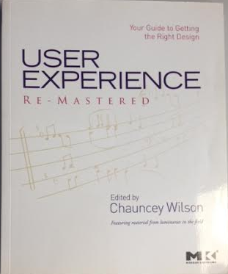

Good UX Books
Design of Everyday Things User Experience Remastered Revised & Expanded Edition Chauncey Wilson Donald Norman

Slide 23
Good UX Web Sites
User Experience Magazine (A UXPA publication) http://uxpamagazine.org/
Boxes and Arrows http://boxesandarrows.com/
UX Matters http://www.uxmatters.com/
Journal of Usability Studies [JUS] (A UXPA publication) http://uxpajournal.org/

Slide 24
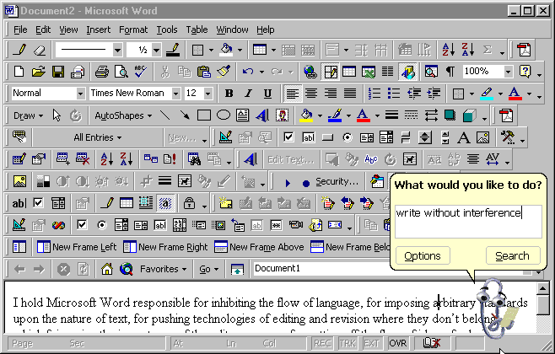
Some commercial example
https://medium.com/beakerandflint/an-introduction-user-experience-design-2a7f8167bf03

Slide 25
Exercise
Individual assignment /
Create heuristic evaluation on:
OMA
This course

